Slide 1
MAXIMUM FLOW
Max-Flow Min-Cut Theorem (Ford Fukerson’s Algorithm)

Slide 2
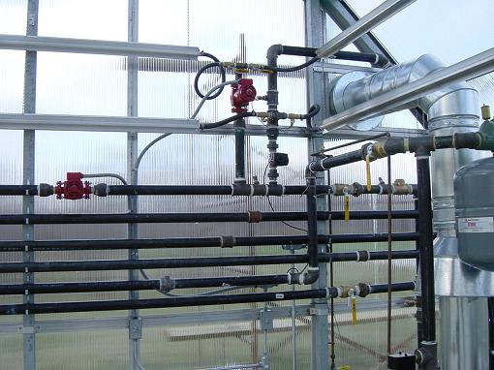
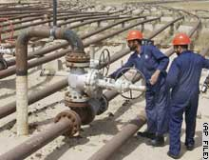
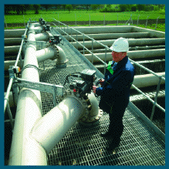
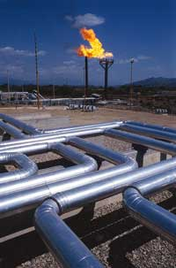
Network Flow

Slide 3
Outline
Network flow definitions
Flow examples
Augmenting Paths
Residual Graph
Ford Fulkerson Algorithm
Cuts
Maxflow-MinCut Theorem

Slide 4
What is Network Flow ?
Flow network is a directed graph G=(V,E) such that each
edge has a non-negative capacity c(u,v)≥0.
Two distinguished vertices exist in G namely :
Source (denoted by s) : In-degree of this vertex is 0.
Sink (denoted by t) : Out-degree of this vertex is 0.
Flow in a network is an integer-valued function f defined
On the edges of G satisfying 0≤f(u,v)≤c(u,v), for every
Edge (u,v) in E.

Slide 5
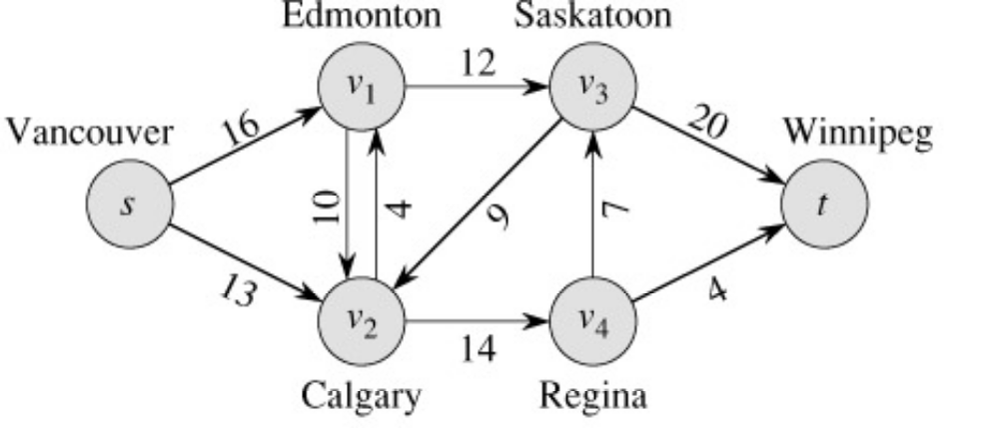
What is Network Flow ?
Each edge (u,v) has a non-negative capacity c(u,v).
If (u,v) is not in E assume c(u,v)=0.
We have source s and sink t.
Assume that every vertex v in V is on some path from s to t.
Following (Fig 26.1a) is an illustration of a network flow:
c(s,v1)=16
c(v1,s)=0
c(v2,s)=0 …

Slide 6
Flow Network as the trucking Problem ?
Problem:
A flow network can model the trucking problem shown in Figure 26.1(a). The Lucky Puck Company has a factory (source s) in Vancouver that manufactures hockey pucks, and it has a warehouse (sink t) in Winnipeg that stocks them.
Lucky Puck space on trucks from another firm to ship the pucks from the factory to the warehouse. Because the trucks travel over specified routes (edges) between cities (vertices) and have a limited capacity, Lucky Puck can ship at most c(u,v) crates per day between each pair of cities u and v in Figure 26.1(a).
Lucky Puck has no control over these routes and capacities, and so the company cannot alter the flow network shown in Figure 26.1(a). They need to determine the largest number p of crates per day that they can ship and then to produce this amount, since there is no point in producing more pucks than they can ship to their warehouse.
Lucky Puck is not concerned with how long it takes for a given puck to get from the factory to the warehouse; they care only that p crates per day leave the factory and p crates per day arrive at the warehouse.
Solution: We can model the “flow” of shipments with a flow in this network because the number of crates shipped per day from one city to another is subject to a capacity constraint. Additionally, the model must obey flow conservation, for in a steady state, the rate at which pucks enter an intermediate city must equal the rate at which they leave. Otherwise, crates would accumulate at intermediate cities.

Slide 7
Conditions for Network Flow
For each edge (u,v) in E, the flow f(u,v) is a real valued function
that must satisfy following conditions :
Flow properties:
1. The capacity constraint: The flow from one vertex to another must be nonnegative and must not exceed the given capacity.
2. The flow-conservation: The total flow into a vertex other than the source or sink must equal the total flow out of that vertex—informally, “flow in equals flow out.”
Capacity Constraint :∀ u,v ∈V, f(u,v) ≤ c(u,v)
Flow Conservation: ∀ u ∈V – {s,t} Σ f(s,v)=0
v∈V
Skew Symmetry : ∀ u,v ∈V, f(u,v)= -f(v,u)

Slide 8
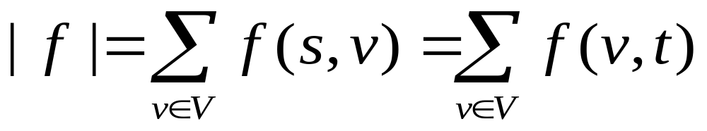
The Value of a Flow.
The value of a flow is given by :
The flow into the node is same as flow going out from the node and
thus the flow is conserved. Also the total amount of flow from source
s = total amount of flow into the sink t.

Slide 9
Example of a flow
Capacity
Flow
/10
1
8
/8
9
1
s
/1
t
/6
6
7
/10
2
Table illustrating Flows and Capacity across different edges of graph above:
f_{s,1} = 9 , c_{s,1} = 10 (Valid flow since 10 > 9)
f_{s,2} = 6 , c_{s,2} = 6 (Valid flow since 6 ≥ 6)
f_{1,2} = 1 , c_{1,2} = 1 (Valid flow since 1 ≥ 1)
f_{1,t} = 8 , c_{1,t} = 8 (Valid flow since 8 ≥ 8)
f_{2,t} = 7 , c_{2,t} = 10 (Valid flow since 10 > 7)
The flow across nodes 1 and 2 are also conserved as flow into them = flow out.

Slide 10
The Maximum Flow Problem
Given a Graph G (V,E) such that:
x_{i,j} = flow on edge (i,j)
u_{i,j}= capacity of edge (i,j)
s = source node
t = sink node
In simple terms maximize
the s to t flow, while ensuring
that the flow is feasible.
Maximize v
Subject To Σ_{j}x_{ij} - Σ_{j}x_{ji} = 0 for each i ≠s,t
Σ_{j}x_{sj} = v
0 ≤ x_{ij} ≤ u_{ij} for all (i,j) ∈ E.

Slide 11
The Ford-Fulkerson Method
Try to improve the flow, until we reach the maximum value of the flow
The residual capacity of the network with a flow f is given by:
The residual capacity (rc) of an edge (i,j) equals c(i,j) – f(i,j) when (i,j)
is a forward edge, and equals f(i,j) when (i,j) is a backward edge.
Moreover the residual capacity of an edge is always non-negative.
1
8,
8
1
1
0
10
,
9
1,
1
9
1
0
8
s
t
s
t
6
7
6,
6
10,
7
0
2
2
3
Original Network
Residual Network

Slide 12
Flow Example
u
20
10
s
30
t
10
20
v

Slide 13
Flow assignment and the residual graph
Imagine if we could look back at the choices we’ve made and undo some of our earlier flow decisions. Turns out we can using something called the residual graph. This is what Matthew was referring to all along.
We’ll basically take our existing graph and update the capacities of all the regular edges to be the current remaining capacity (c_{e} - f_{e}). We’ll then add back edges indicating the amount of flow currently going across this edge. We can then use that back edge to decrease flow in order to try out alternate flow allocations.

Slide 14
Flow assignment and the residual graph
u
u
15/20
0/10
5
10
15
s
15/30
t
15
15
s
t
5
5/10
20/20
5
20
v
v

Slide 15
The Ford-Fulkerson Method
Begin
x := 0; // x is the flow.
create the residual network G(x);
while there is some directed path from s to t in G(x) do
begin
let P be a path from s to t in G(x);
Δ:= δ(P);
send Δunits of flow along P;
update the r's;
end
end {the flow x is now maximum}.
Click To See Ford Fulkerson’s Algorithm In Action (Animation)

Slide 16
Augmenting Paths ( A Useful Concept )
Definition:
An augmenting path p is a simple path from s to t on a residual network
that is an alternating sequence of vertices and edges of the form
s,e₁,v₁,e₂,v₂,...,e_{k},t in which no vertex is repeated and no forward edge
is saturated and no backward edge is free.
Characteristics of augmenting paths:
We can put more flow from s to t through p.
The edges of residual network are the edges on which residual capacity
is positive.
We call the maximum capacity by which we can increase the flow on p
the residual capacity of p.

Slide 17
The Ford-Fulkerson’s Algorithm
FORDFULKERSON(G,E,s,t)
FOREACH e ∈ E
f(e) ← 0
G_{f} ← residual graph
WHILE (there exists augmenting path P)
f ← augment(f, P)
update G_{f}
ENDWHILE
RETURN f
AUGMENT(f,P)
b ← bottleneck(P)
FOREACH e ∈ P
IF (e ∈ E)
// backwards arc
f(e) ← f(e) + b
ELSE
// forward arc
f(e^{R}) ← f(e) - b
RETURN f
Click To See Ford Fulkerson’s Algorithm In Action (Animation)

Slide 18
Proof of correctness of the algorithm
Lemma: At each iteration all residual capacities are integers.
Proof: It’s true at the beginning. Assume it’s true after the first
k-1 augmentations, and consider augmentation k along path P.
The residual capacity Δ of P is the smallest residual capacity
on P, which is integral.
After updating, we modify the residual capacities by 0 or Δ,
and thus residual capacities stay integers.
Theorem: Ford-Fulkerson’s algorithm is finite
Proof: The capacity of each augmenting path is atleast 1. The
augmentation reduces the residual capacity of some edge (s,j)
and doesn’t increase the residual capacity for some edge (s,i)
for any i.
So the sum of residual capacities of edges out of s keeps decr-
easing, and is bounded below 0.
Number of augmentations is O(nC) where C is the largest of the
capacity in the network.

Slide 19
When is the flow optimal ?
A flow f is maximum flow in G if :
The residual network G_{f} contains no more augmented paths.
| f | = c(S,T) for some cut (S,T) (a min-cut)
Proof:
Suppose there is an augmenting path in G_{f} then it implies that
the flow f is not maximum, because there is a path through which
more data can flow. Thus if flow f is maximum then residual n/w
G_{f} will have no more augmented paths.
(2) Let v=Fx(S,T) be the flow from s to t. By assumption v=CAP(S,T)
By Weak duality, the maximum flow is at most CAP(S,T). Thus the
flow is maximum.

Slide 20
15.082 and 6.855J (MIT OCW)
The Ford-Fulkerson Augmenting Path Algorithm for the Maximum Flow Problem

Slide 21
Flow Example
u
20
10
s
30
t
10
20
v

Slide 22
Flow assignment and the residual graph
u
u
15/20
0/10
5
10
15
s
15/30
t
15
15
s
t
5
5/10
20/20
5
20
v
v

Slide 23
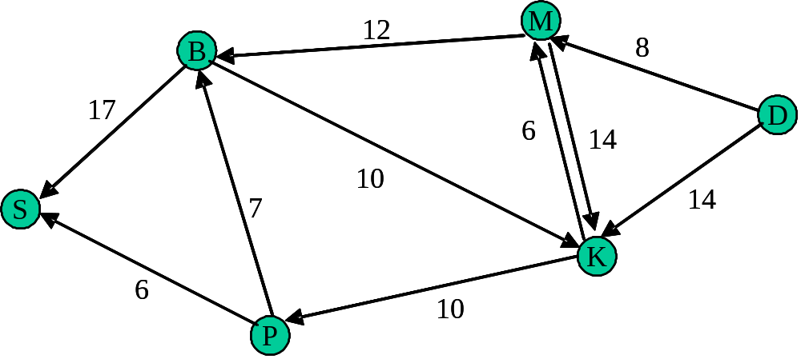
Example: Maximum Flow Problem
SINK:
Node with net inflow;
Consumption point
CAPACITY:
Maximum flow
on an edge
SOURCE:
Node with net outflow:
Production point
Efficient method to solve such problems: Ford-Fulkerson Method

Slide 24
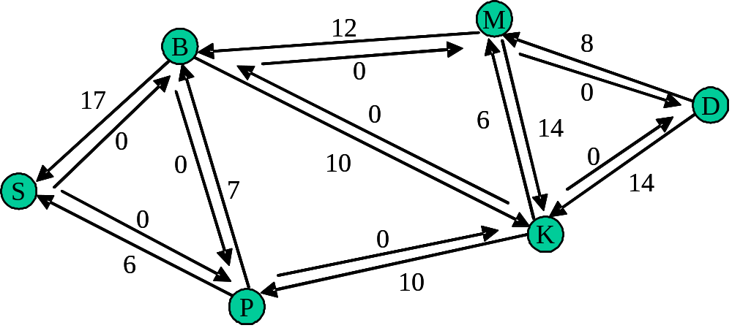
Example: Ford-Fulkerson Method
Step 1. Add 0-capacity links to pair ‘one-way’ edges
Step 1

Slide 25
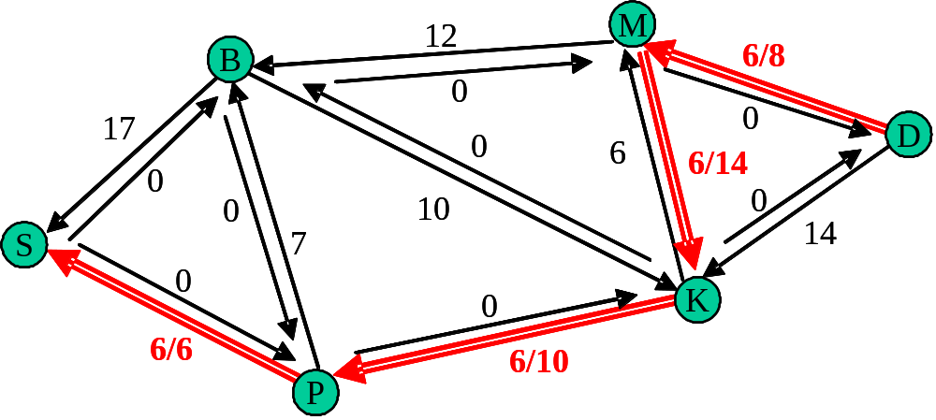
Ford-Fulkerson Method: Find an augmentation path
Step 2. Find a positive flow from Source → Sink
Flow, f = 6 units

Slide 26
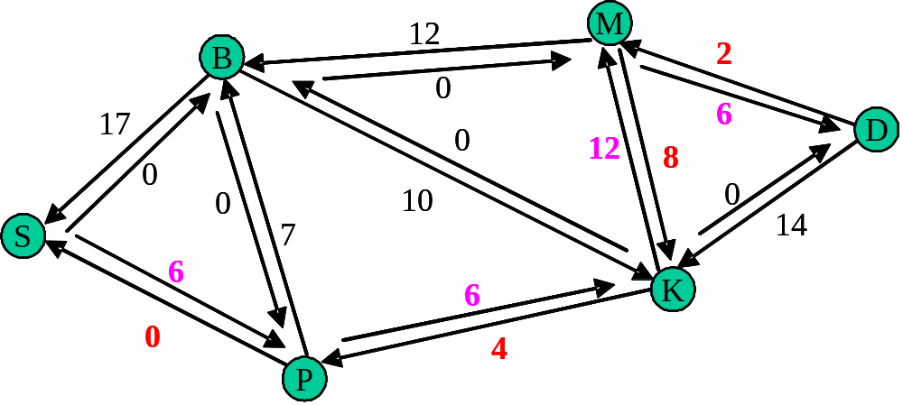
Ford-Fulkerson Method...
Step 3. Update the residual network due to flow f
Current total flow: 6

Slide 27
Ford-Fulkerson Method….
Augmentation path: <D, M, B, S>
Max flow: 2
Current total flow: 6+2
Residual network
10
M
B
0
2
15
8
D
0
0
12
12
8
2
8
0
10
0
0
10
0
14
7
14
S
7
6
6
K
6
6
0
0
4
4
P

Slide 28
Ford-Fulkerson Method…..
10
M
Augmentation path: <D, K, M, B, S>
Max flow: 10
B
0
2
15
8
D
0
0
12
12
8
2
8
0
10
0
0
10
0
14
7
14
S
7
6
6
6
K
6
0
0
4
4
Current total flow: 6+2+10
Residual network
P
0
M
B
0
12
5
8
D
0
0
2
18
12
10
10
0
10
0
7
4
S
7
6
K
6
0
4
P

Slide 29
Ford-Fulkerson Method……
0
M
Augmentation path: <D, K, P, B, S>
Max flow: 4
B
0
12
5
8
D
0
0
2
18
12
10
10
0
10
0
7
4
S
7
6
6
K
0
4
P
Current total flow: 6+2+10+4
Residual network
0
M
B
0
12
1
8
D
0
No more
Augmentation paths
➔ DONE
0
2
18
16
14
10
4
3
10
S
0
6
10
K
0
0
P

Slide 30
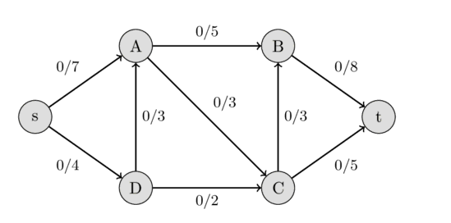
Example: Ford-Fulkerson Max Flow

Slide 31
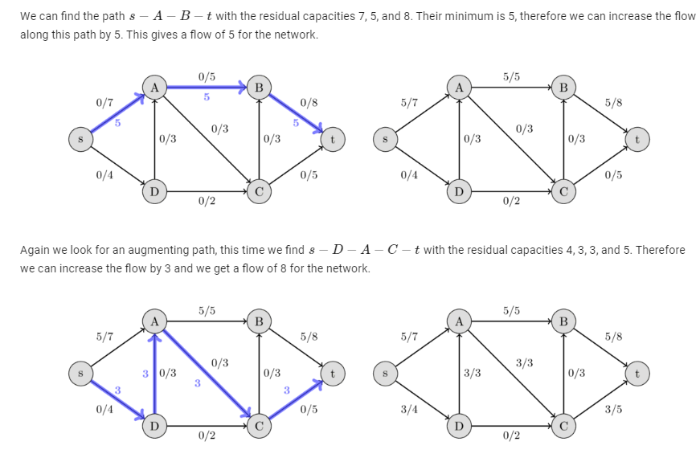
Example: Ford-Fulkerson Max Flow

Slide 32
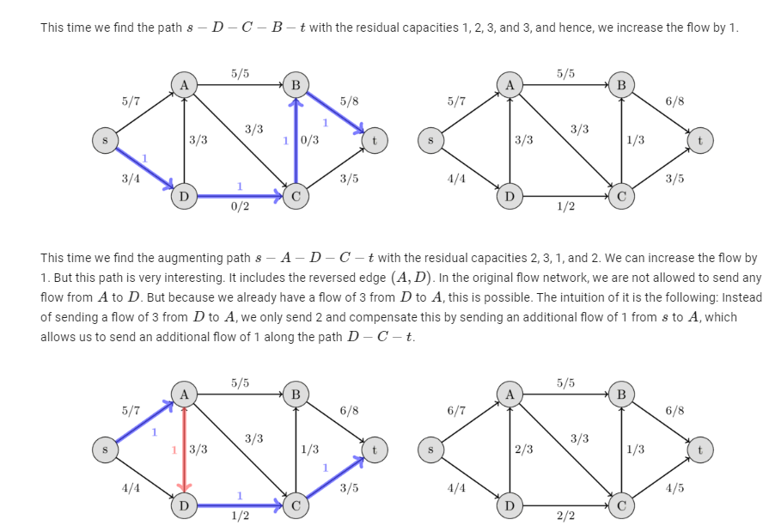
Example: Ford-Fulkerson Max Flow

Slide 33
Example: Ford-Fulkerson Max Flow
4
2
5
3
1
1
1
2
2
s
4
t
3
2
1
3
This is the original network, plus reversals of the arcs.

Slide 34
Ford-Fulkerson Max Flow
4
2
5
3
1
1
1
2
2
s
4
t
3
2
1
3
This is the original network, and the original residual network.

Slide 35
Ford-Fulkerson Max Flow
4
2
5
3
1
1
1
2
2
s
4
t
3
2
1
3
Find any s-t path in G(x)

Slide 36
Ford-Fulkerson Max Flow
4
2
5
3
1
1
1
2
1
2
s
4
t
2
1
3
2
1
1
1
3
Determine the capacity Δ of the path.
Send Δ units of flow in the path.
Update residual capacities.

Slide 37
Ford-Fulkerson Max Flow
4
2
5
3
1
1
1
2
1
2
s
4
t
2
1
3
2
1
1
1
3
Find any s-t path

Slide 38
Ford-Fulkerson Max Flow
4
2
5
3
1
1
1
2
1
1
1
s
4
t
2
1
1
3
2
2
1
1
1
1
3
1
Determine the capacity Δ of the path.
Send Δ units of flow in the path.
Update residual capacities.

Slide 39
Ford-Fulkerson Max Flow
4
2
5
3
1
1
1
2
1
1
1
s
4
t
2
1
1
3
2
2
1
1
1
1
3
1
Find any s-t path

Slide 40
Ford-Fulkerson Max Flow
4
2
5
3
1
1
1
1
1
1
s
4
t
1
2
1
2
2
3
1
1
1
1
3
1
Determine the capacity Δ of the path.
Send Δ units of flow in the path.
Update residual capacities.

Slide 41
Ford-Fulkerson Max Flow
4
2
5
3
1
1
1
1
2
1
1
s
4
t
1
2
1
2
2
3
1
1
1
1
3
1
Find any s-t path

Slide 42
Ford-Fulkerson Max Flow
4
2
5
3
1
1
1
1
2
1
1
s
4
t
1
2
1
1
2
2
1
1
1
2
1
2
3
1
Determine the capacity Δ of the path.
Send Δ units of flow in the path.
Update residual capacities.

Slide 43
Ford-Fulkerson Max Flow
4
2
5
3
1
1
1
1
2
1
1
s
4
t
1
2
1
1
2
2
1
1
2
1
2
3
1
Find any s-t path

Slide 44
Ford-Fulkerson Max Flow
4
3
2
5
1
3
1
2
1
1
1
1
s
4
t
1
2
1
1
2
2
1
1
2
1
2
3
1
Determine the capacity Δ of the path.
Send Δ units of flow in the path.
Update residual capacities.

Slide 45
Ford-Fulkerson Max Flow
4
3
2
5
1
3
1
2
1
1
1
1
s
4
t
1
2
1
1
2
2
1
1
2
1
2
3
1
There is no s-t path in the residual network. This flow is optimal

Slide 46
Ford-Fulkerson Max Flow
4
3
2
2
5
5
1
3
1
2
1
1
1
1
s
s
4
4
t
1
2
1
1
2
2
1
1
2
1
2
3
1
3
These are the nodes that are reachable from node s.

Slide 47
Ford-Fulkerson Max Flow
1
2
5
1
1
2
2
s
4
t
2
2
3
Here is the optimal flow

Slide 48
Methods
Max-Flow Min-Cut Theorem
The Ford-Fulkerson Method
The Preflow-Push Method

Slide 49
Cuts of Flow Networks
A Cut in a network is a partition of V into S and T (T=V-S) such that
s (source) is in S and t (target) is in T.
2
9
5
Cut
10
4
15
15
10
s
5
3
8
6
10
t
4
6
15
10
15
4
30
7

Slide 50
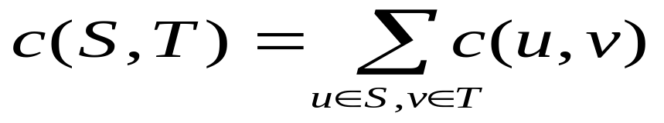
Capacity of Cut (S,T)
2
9
5
Cut
10
4
15
15
10
s
5
3
8
6
10
t
4
6
15
10
15
Capacity = 30
4
30
7

Slide 51
Min Cut
Min s-t cut (Also called as a Min Cut) is a cut of minimum capacity
2
9
5
Min s-t Cut
10
4
15
15
10
s
5
3
8
6
10
t
4
6
15
10
15
Capacity = 28
4
30
7

Slide 52
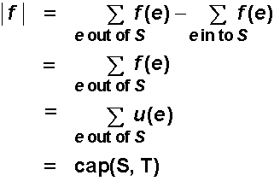
Flow of Min Cut (Weak Duality)
Let f be the flow and let (S,T) be a cut. Then | f | ≤ CAP(S,T).
In maximum flow, minimum cut problems forward edges are full
or saturated and the backward edges are empty because of the
maximum flow. Thus maximum flow is equal to capacity of cut.
This is referred to as weak duality.
Proof :
0
S
T
8
t
s
7

